Slide 1

Indian Institute of Remote Sensing, ISRO
Module: 4 Big Data Analytics
Crop Yield Prediction Using
Big Data Techniques
Submitted By
Group 2
Submitted To
Mr. Kapil Oberai (Scientist)

Slide 2
Group members
Sr.no | Name | Student ID | Contribution
1 | Gusai Nidhi | 202319015 | Create AutoML Regressor, Linear Regression Model in BigQueryML and Report and PPT Creation
2 | Nayakapara Drashti | 202319019 | Create Random Forest Regressor and Boosted Tree Regressor L1 Model in BigQueryML, Dashboard Creation
3 | Prajapati Divya | 202319024 | Project Idea and Data Finding, Dashboard Creation and Report and PPT Creation and Finalization

Slide 3
Introduction
In recent years, the agriculture sector has been transforming towards data-driven solutions to solve real-time problems through advancements in technology and data analytics.
One of the critical area in which advanced technologies are used is crop yield prediction which helps Farmers, the National Food Security Department, policymakers, and stockholders to make informed decisions based on yield predictions.
It also leads to optimizing resource allocations and mitigating risks associated with agricultural production.

Slide 4



Objectives
To get exposure to big data techniques.
Yield Prediction Through Google Cloud Big Query ML
To create an insightful dashboard for crop yield analysis using Google Loocker Studio and knowage

Slide 5
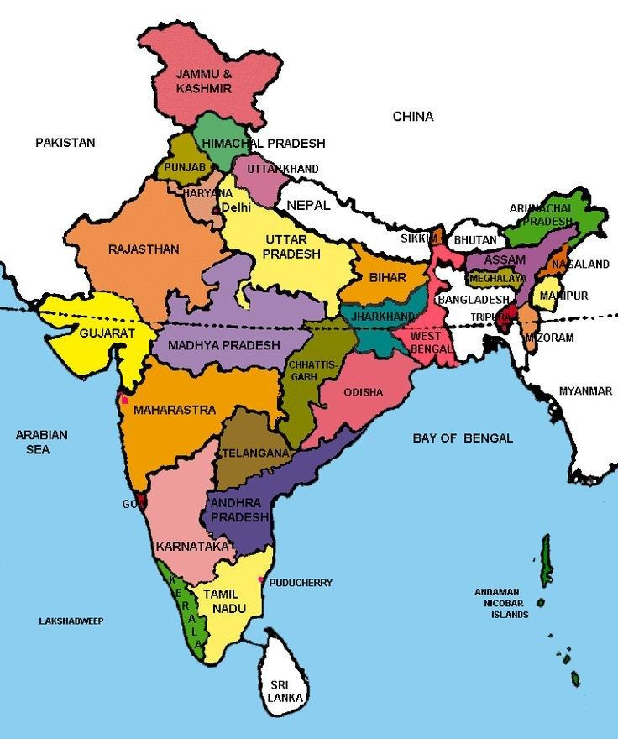
Study Area

Slide 6
Dataset and Parameters
This dataset encompasses agricultural data for multiple crops cultivated across various states in India from the year 1997 to 2020.
Crop: The name of the crop cultivated.
Crop Year: The year in which the crop was grown.
Season: The specific cropping season (e.g., Kharif, Rabi, Whole Year).
State: The Indian state where the crop was cultivated.
Area: The total land area (in hectares) under cultivation for the specific crop.
Production: The quantity of crop production (in metric tons).
Annual Rainfall: The annual rainfall received in the crop-growing region (in mm).
Fertilizer: The total amount of fertilizer used for the crop (in kilograms).
Pesticide: The total amount of pesticide used for the crop (in kilograms).
Yield: The calculated crop yield (production per unit area).
Link of Dataset: Agricultural Crop Yield in Indian States Dataset (kaggle.com)

Slide 7
Why BigQuery and Google Looker Studio?
Google BigQuery provides cloud computing facilities that make handling large data much easier.
It offers a user-friendly guide for creating and training machine learning models.
With just a few lines of SQL query, users can create machine learning models, train them and even evolve them.
BigQuery takes care of the whole machine learning pipeline, including standardization and hyperparameter tuning.
Looker Studio is a FREE tool that is accessible and convenient for anyone to use.
Dashboard with customizable reports: Looker Studio grants users the ability to generate custom reports with an extensive range of designs, styles, formatting, and graphs. Also, there are Pre-designed templates that can be useful if you are new to Looker Studio.
Contemporary & Interactively connected Data Visualizations.

Slide 8
Flow chart
Data finding and downloading
Create Table using SQL Queries
Data importing in Big Query ML
ML model evaluation
Yield prediction Using different regression models
Create regression models
Dashboard creation

Slide 9
Algorithm Used
Linear regression
AutoML regression
Linear regression with L1 regularization
Random Forest Regressor
Boosted Tree regressor

Slide 10
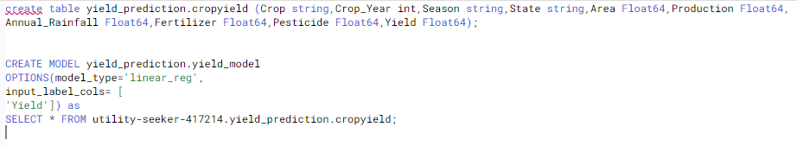
Linear regression
A linear relationship between independent factors and a continuous dependent variable is fitted using the statistical technique of linear regression to forecast. It forecasts numerical results that fall within a given range and are not endless or undefinable.

Slide 11
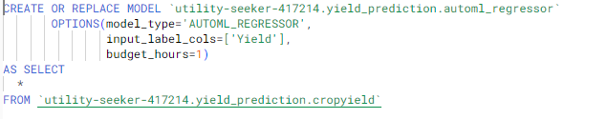
Auto ML Regressor
The outcome variable that is being predicted is usually represented by a label column with numeric data type in the regression model. Regression analysis requires mathematical processes, which are made easier by numerical data. The model can learn and predict continuous numerical values by include this column, which enables it to produce precise forecasts based on the input features.

Slide 12
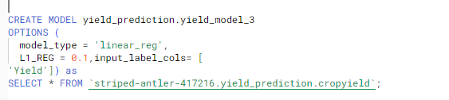
L1 regularization
Lasso regression, also known as linear regression with L1 regularization, aims to minimize the sum of the absolute values of the coefficients. By promoting sparse solutions, this regularization method significantly lowers model complexity and may even enhance generalization performance, which helps in feature selection

Slide 13
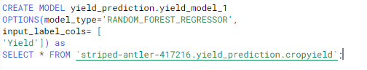
Random Forest Regressor
A machine learning approach called Random Forest builds several decision trees using various data subsets. By averaging these trees' results, it improves the accuracy of its predictions. It reduces overfitting problems by merging several predictions, creating a strong model that can produce precise classifications or predictions.

Slide 14
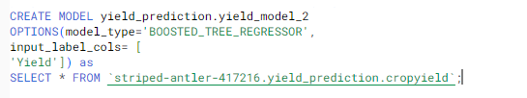
Boosted Tree Regression
BigQuery uses Boosted Tree Regression for predictive modeling tasks involving huge datasets. When solving regression issues, it is employed to forecast a continuous numerical value. They combine numerous weak learners repeatedly and provide excellent predictive accuracy.

Slide 15
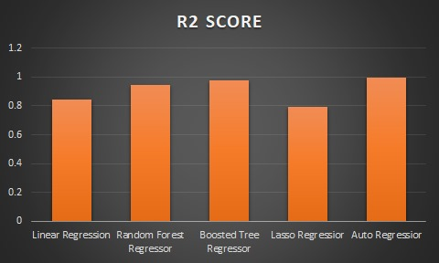
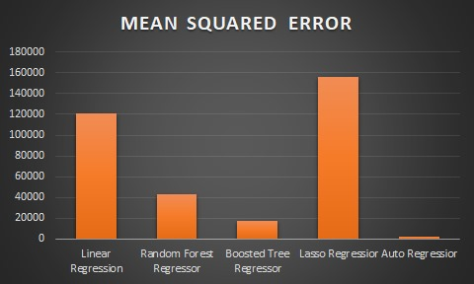
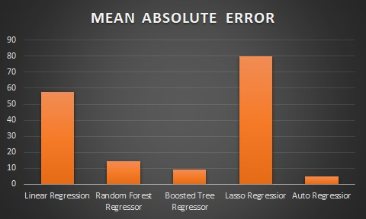
Results of Models

Slide 16
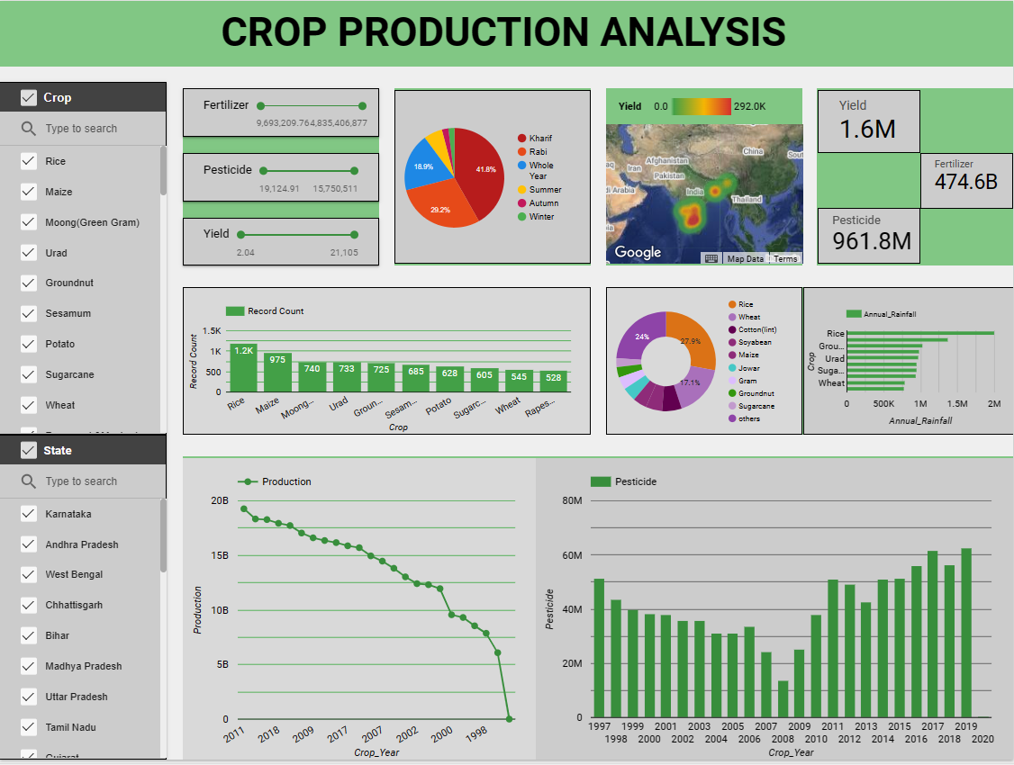
Dashboard By Google Looker Studio
Link of dashboard by Google looker Studio: https://lookerstudio.google.com/reporting/b0cc6f82-425b-451c-b012-0826b2bc2a1e

Slide 17
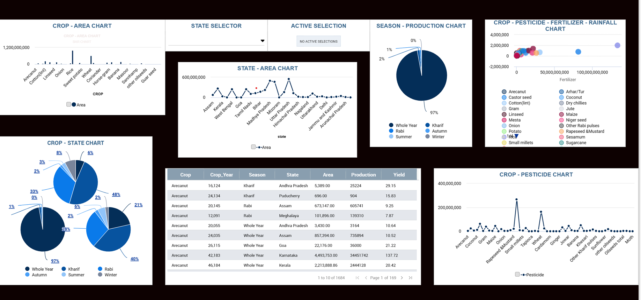
Dashboard By Knowage
Link of dashboard by Knowage: https://demo.knowage-suite.com/knowage-vue/document-browser/document-composite/dashboard

Slide 18
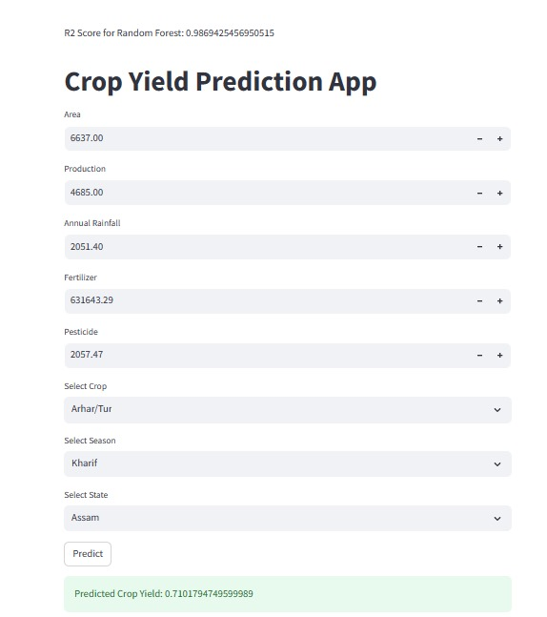
MODEL DEPLOY USING STREAMLIT LIBRARY
https://drive.google.com/drive/folders/1GePiIDk5G9CIaZd0d2GrcvCPlU17j_Sk?usp=drive_link

Slide 19
THANK YOU

